Slide 1
PLEASE DOWNLOAD THE SLIDO APP ON YOUR SMARTPHONE

Slide 2
Diabetes
Dr. Salima Latif
GP Teaching
January 2024

Slide 3
Objectives
Types of Diabetes
Type 2 Diabetes
Diagnosis
Lifestyle measures
Oral diabetic drug treatments
Injectable drug treatments
Diabetes and illness and Emergencies
Quiz

Slide 4
Types of Diabetes
Type 1
Type 2
MODY (maturity onset diabetes of the young)
LADA (latent autoimmune diabetes in adults),
Pancreatic Diabetes (Type 3C Diabetes)
Pre-diabetes, (Non-diabetic hyperglycaemia)
Gestational diabetes

Slide 5
Exercise - Explaining Type 2 Diabetes Mellitus
Patient
David Moore
50 yo , BMI 32
PMHx. HTN on rampril 10mg
SHx. Alcohol nil, bus driver
Attending for results of blood test and urine test today. MSU, U&Es and PSA normal. Hba1c 68
Last consultation – attended with frequency of urine and nocturia for 6/12. No haematuria. Abdo and Prostate exam normal. BP normal. Bloods and MSU requested.

Slide 6
Type 2 Diabetes - What do you cover in the initial consultations ?
What type 2 diabetes is
How does it impact on Health
Target hba1c
Regular Checks/ monitoring
How to manage it – diet, exercise, medication
Where to get more information

Slide 7
Diagnosis
HbA1c of 48 mmol/mol (6.5%) or more.
Fasting plasma glucose level of 7.0 mmol/L or more.
Random plasma glucose of 11.1 mmol/L or more in the presence of symptoms or signs of diabetes.
If the person is symptomatic, a single abnormal HbA1c or fasting plasma glucose level can be used, although repeat testing is sensible to confirm the diagnosis.
If the person is asymptomatic, do not diagnose diabetes on the basis of a single abnormal HbA1c or plasma glucose result.
Any patient over 60 with weight loss and new diagnosis of diabetes should have urgent upper abdominal imaging to exclude pancreatic cancer
Notes:
Arrange repeat testing, preferably with the same test, to confirm the diagnosis. If the repeat test result is normal, arrange to monitor the person for the development of diabetes, the frequency depending on clinical judgement.

Slide 8
Symptoms and Symptoms
Polydipsia,
Polyuria,
Blurred vision,
Unexplained weight loss,
Recurrent infections,
Tiredness
Acanthosis nigricans

Slide 9
Dietary Advice
-High-fibre, low-glycaemic-index sources of carbohydrate, such as fruit, vegetables, wholegrains and pulses
-choosing low-fat dairy products
- eating oily fish
-control intake of saturated and trans fatty acids.

Slide 10
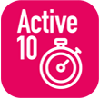
Notes:
https://assets.publishing.service.gov.uk/government/uploads/system/uploads/attachment_data/file/1054541/physical-activity-for-adults-and-older-adults.pdf
Diabetes.co.uk – diabetes and exercise

Slide 11
Hba1C measurement and targets
Measure HbA1c levels in adults with type 2 diabetes every:
- 3 to 6 months until HbA1c is stable on unchanging therapy
- 6 months once the HbA1c level and blood glucose lowering therapy are stable.
Discuss and agree an individual HbA1c target with adults with type 2 diabetes
Target HbA1c 48 mmol/mol when managed by lifestyle and diet, or lifestyle and diet combined with a single drug not associated with hypoglycaemia
Target HbA1c 53 mmol/mol where patient is on more than one drug and the Hba1C rises above 58 mmol/mol
Notes:
In adults with type 2 diabetes, if HbA1c levels are not adequately controlled by a single drug and rise to 58 mmol/mol (7.5%) or higher:
reinforce advice about diet, lifestyle and adherence to drug treatment and
support the person to aim for an HbA1c level of 53 mmol/mol (7.0%) and
intensify drug treatment.

Slide 12
John
51 year old
Type 2 Diabetes diagnosed 2 years ago
Hx of Myocardial infarction, smoker 10/day
On ramipril 2.5mg, bisoprolol 2.5mg, Aspirin 75mg, Atorvastatin 80mg, metformin 500mg twice a day
Current Hba1C 62,
6 months ago Hba1c was 60
BMI 34

Slide 15
Metformin
Improves Insulin sensitivity and peripheral glucose uptake
Reduces hepatic glucose production
High Hba1c efficacy ( 7-22 mmol/mol)
Weight neutral
Hypoglycemia is rare
Reduction in microvascular Disease and improved cardiovascular outcomes

Slide 16
SGLT-2 Inhibitors
Increases urinary excretion of glucose
Canagliflozin, dapagliflozin, Emplagliflozin, Ertugliflozin
Moderate Hba1c efficacy (6 – 14 mmol/mol)
Weight loss (2-3kg)
Hypoglycaemia is rare
Cardioprotective benefits particularly in heart failure
Renal benefits
Risk of genitourinary Infection
Increased risk of euglycaemia DKA
Rarely associated with Fournier’s gangrene – necrotizing fasciitis of the perineum
Notes:
Modest benefits in MACE outcomes in patients with established cardiovascular disease
Risk of DKA highest in patients with low beta reserve, ketogenic diet, severe dehydration, insulinopenic, excess alcohol consumption, patients who have had surgery,
Use with caution in patients with BMI <25 , SA BMI <23

Slide 17
Exercise - Practice initiating patient on an SGLT2 Inhibitor
52 year old Anita attended with a hba1c of 68.
eGFR 70, Urine A:Cr 4.2.
BP 130/78, BMI 28. Qrisk 14%
PMHx. T2DM, HTN and hypercholesterolaemia
On metformin 1g BD, atorvastatin 20mg, Ramipril 10mg
Please discuss commencing an SGLT2I in this patient.
Discuss mechanism of action
How to take
Benefits
Side effects
Sick day rules
Risks – DKA and fourniers gangrene
Foot care
Notes:
Prescribe an SGLT-2 inhibitor with caution in people with:
History of foot ulcer, peripheral arterial disease, or lower limb amputation — increased risk of lower limb amputation (mainly toes) with canagliflozin. Advise to stop treatment if signs of a foot complication such as skin ulceration, discolouration, infection, or new pain/tenderness, and seek urgent medical assessment.

Slide 18
Sarah
39-year-old female
Feels fatigued
Past Medical History: Diabetes diagnosed in 2018, Hypertension,
Medication: Metformin MR 2g, Gliclazide 160mg am and 80mg pm, sitagliptin 100mg, Ramipril 1.25mg, amlodipine 10mg,
Blood test: Jan 2024 hba1c 105, Aug 2023 hba1c 94, May 2022 hba1c 104, Normal renal function
Weight: 122.5kg, Body Mass Index 40

Slide 19
Sulphonylureas
Gliclazide, Glipizide, Tolbutamide, Glimepiride
Stimulates the pancreas to produce insulin
High hba1c efficacy (11 -22 mmol/mol)
Works quickly
Can be used for symptomatic hyperglycemia
Can cause hypoglycaemia
Associated with weight gain
Lack of durability

Slide 20
Pioglitazone
Increases insulin sensitivity
High hba1c efficacy (11 – 17 mmol/mol)
Rare hypoglycaemia
Good durability
Favorable lipid profile
Disadvantages – weight gain, fluid retention, risk of fractures, reports of bladder cancer
Contraindicated – Hx of bladder cancer, uninvestigated macroscopic haematuria, heart failure, macular oedema

Slide 21
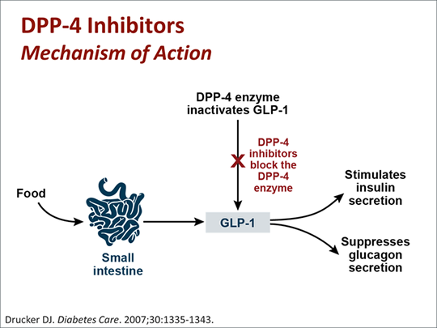
Incretin Based therapies
Notes:
Rapidly inactivated by DPP4 enzyme (half life 1-2 mins for GLP-1 and 7 mins for GIP (Glucose dependent Insuliontropic Polypeptide)
Injected GLP-1 increases amount of GLP-1 available and improves pancreatic response to ingested glucose
They have resistant properties to DPP4 due to chemical or changes in the amino acid sequence
Suppresses glucagon secretion in the alpha cells. Delays gastric emptying. Also promotes satienty in the brain and reduced appetits

Slide 22
DPP-4 Inhibitors (Gliptins)
Increases insulin secretion from the pancreas in response to ingestion of food
Alogliptin, Linagliptin, Saxagliptin, Sitagliptin, Vidagliptin
Modest efficacy ( 7-9 mmol/mol)
Hypoglycaemia is rare
Weight neutral
Well tolerated

Slide 23
GLP-1 Analogues
Increases Glucose dependent insulin secretion in pancreas
Suppresses post-prandial glucagon secretion
Reduces hepatic glucose output
Slows gastric emptying
Promotes satiety and reduces appetite
High efficacy (17 – 23 mmol/mol)
Dulaglutide, Exenetide, Lixisenatide, Liraglutide, Semaglutide
Weight loss
Hypoglycaemia rare
Significant reduction in MACE
Contraindicated in pancreatitis

Slide 24
Tirzepatide
Is a GLP-1 analogue that is combined with a GIP analogue
The National Institute for Health and Care Excellence (NICE) approved Tirzepatide (brand name Mounjaro) in October 2023 for treating type 2 diabetes on the NHS in England and Wales, and we await more details on when supplies will become available.
Studies have been shown to significantly reduce blood sugar levels and body weight in patients with diabetes when compared with semaglutide, insulin therapy, or a placebo.

Slide 25
Sarah Ctd…..
6 months after initiation of Ozempic Sarah’s hba1c was 54 and her weight 115kg (9% weight loss).
She was on ozempic 1mg, metformin 2mg MR and gliclazide 30mg MR.
NICE (2022) recommendations for continuing GLP-1
a reduction of at least 11 mmol/mol and weight loss of at least 3% at 6 months of therapy.

Slide 26
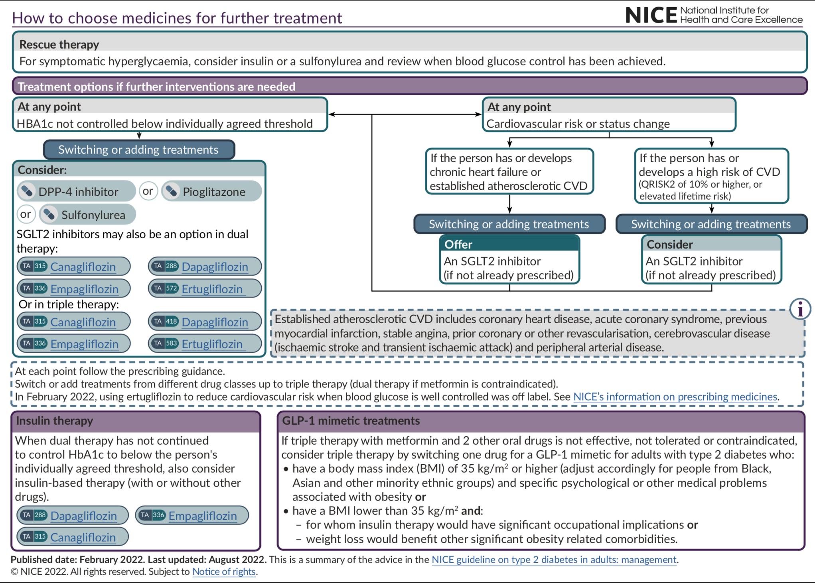

Slide 27
Exercise –Practice initiating patient on gliclazide
46 year old Heather has booked an appointment to see you as she has been feeling fatigued and has nocturia which is keeping her up at night. She has had type 2 diabetes for 2 years and her last hba1c 1 month ago was 86. Renal function and urine A:Cr normal. BMI 32
She missed her last appointment in the diabetes clinic.
She is taking metformin 500mg BD.
Please discuss commencing gliclazide in this patient.
Discuss mechanism of action
How to take
Side effects
Risk of hypos
How to treat hypos
Do they need to test CBG?
Follow-up

Slide 28
NICE - Self-monitoring of capillary blood glucose
These recommendations relate to self-monitoring by capillary blood glucose monitoring.
1.6.12 Take the Driver and Vehicle Licensing Agency (DVLA)'s Assessing fitness to drive: a guide for medical professionals into account when offering self‑monitoring of capillary blood glucose levels for adults with type 2 diabetes. [2015, amended 2022]
1.6.13 Do not routinely offer self-monitoring of capillary blood glucose levels for adults with type 2 diabetes unless:
the person is on insulin or
there is evidence of hypoglycaemic episodes or
the person is on oral medication that may increase their risk of hypoglycaemia while driving or operating machinery or
the person is pregnant or is planning to become pregnant (see the NICE guideline on diabetes in pregnancy). [2015, amended 2022]

Slide 29
When would you consider insulin?
On three oral diabetic medication and not achieving hba1c target
Unable to tolerate other medication
Other medication contraindicated
Relieve symptoms associated with hyperglycaemia
In preparation and during pregnancy
During illness/ high dose steroid use
In preparation for surgery (hba1c > 69mmol/mol)
During surgery and post-operatively
Post MI during inpatient stay

Slide 30
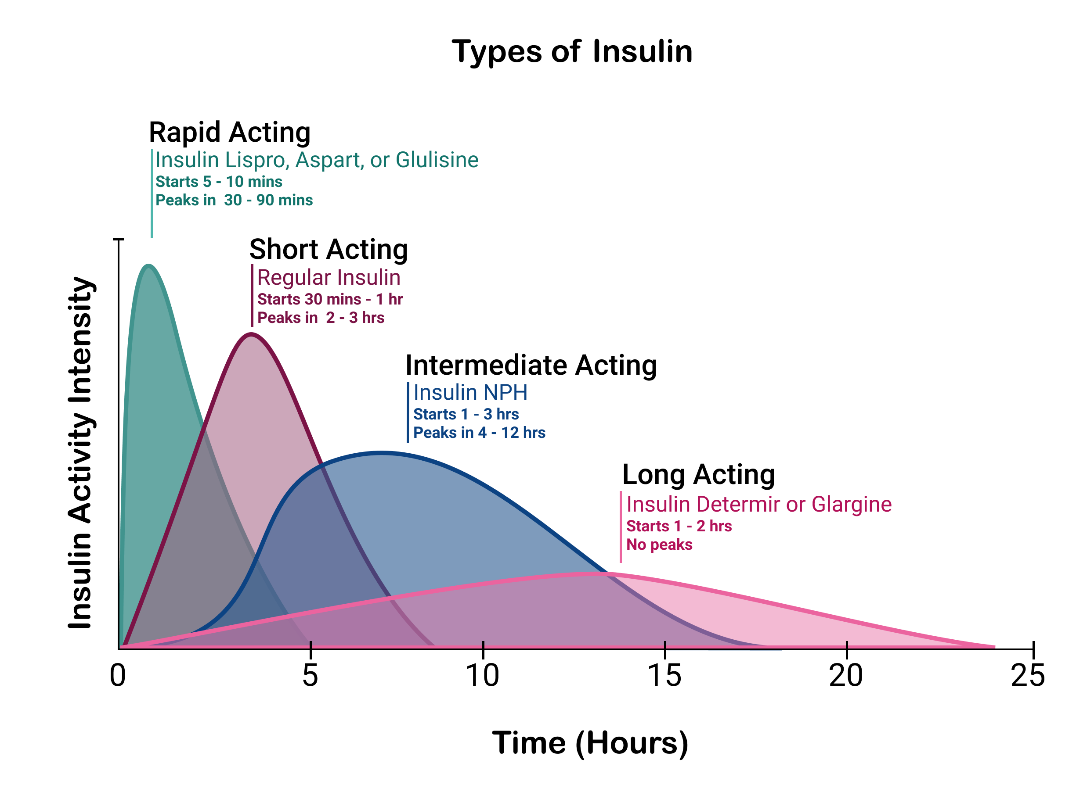

Slide 31
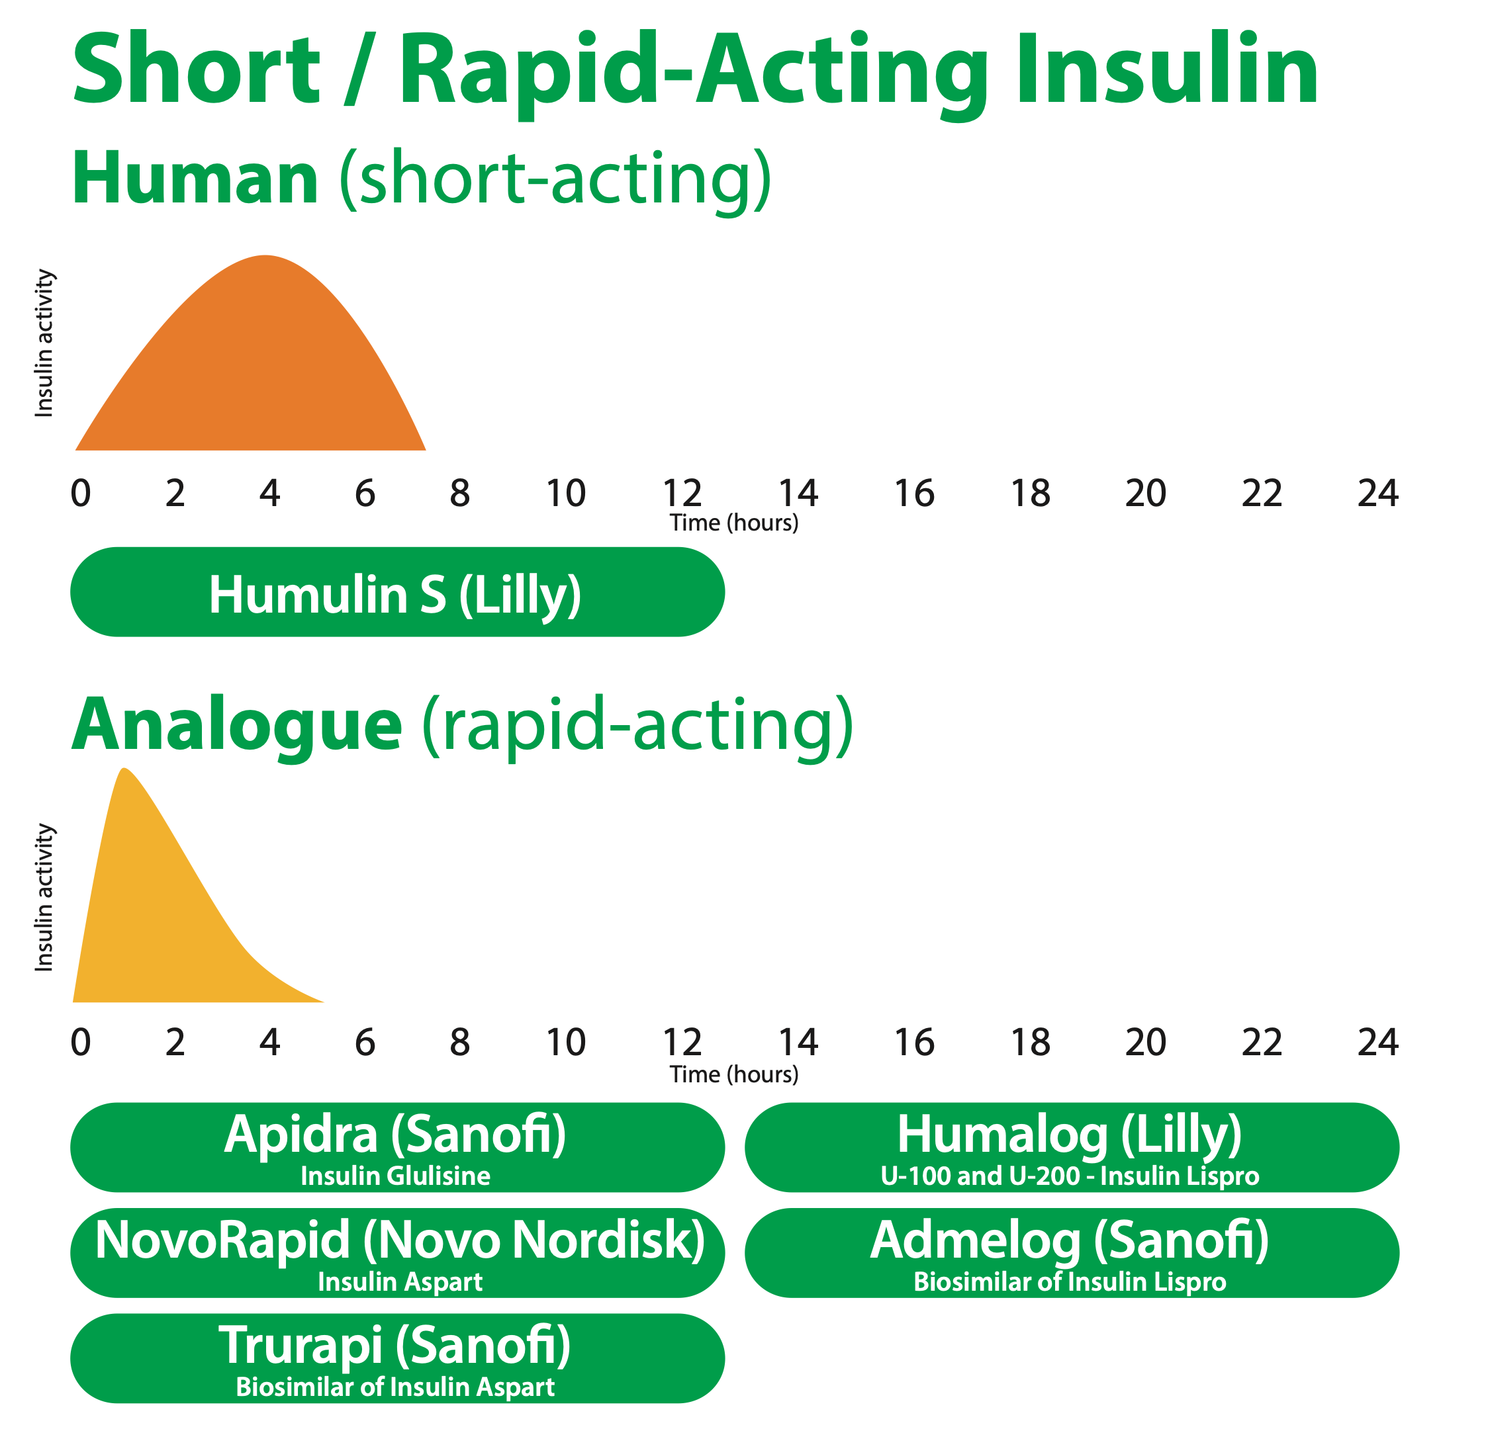
Notes:
Taken From PITstop Course Resources (pitstopdiabetes.co.uk)

Slide 32
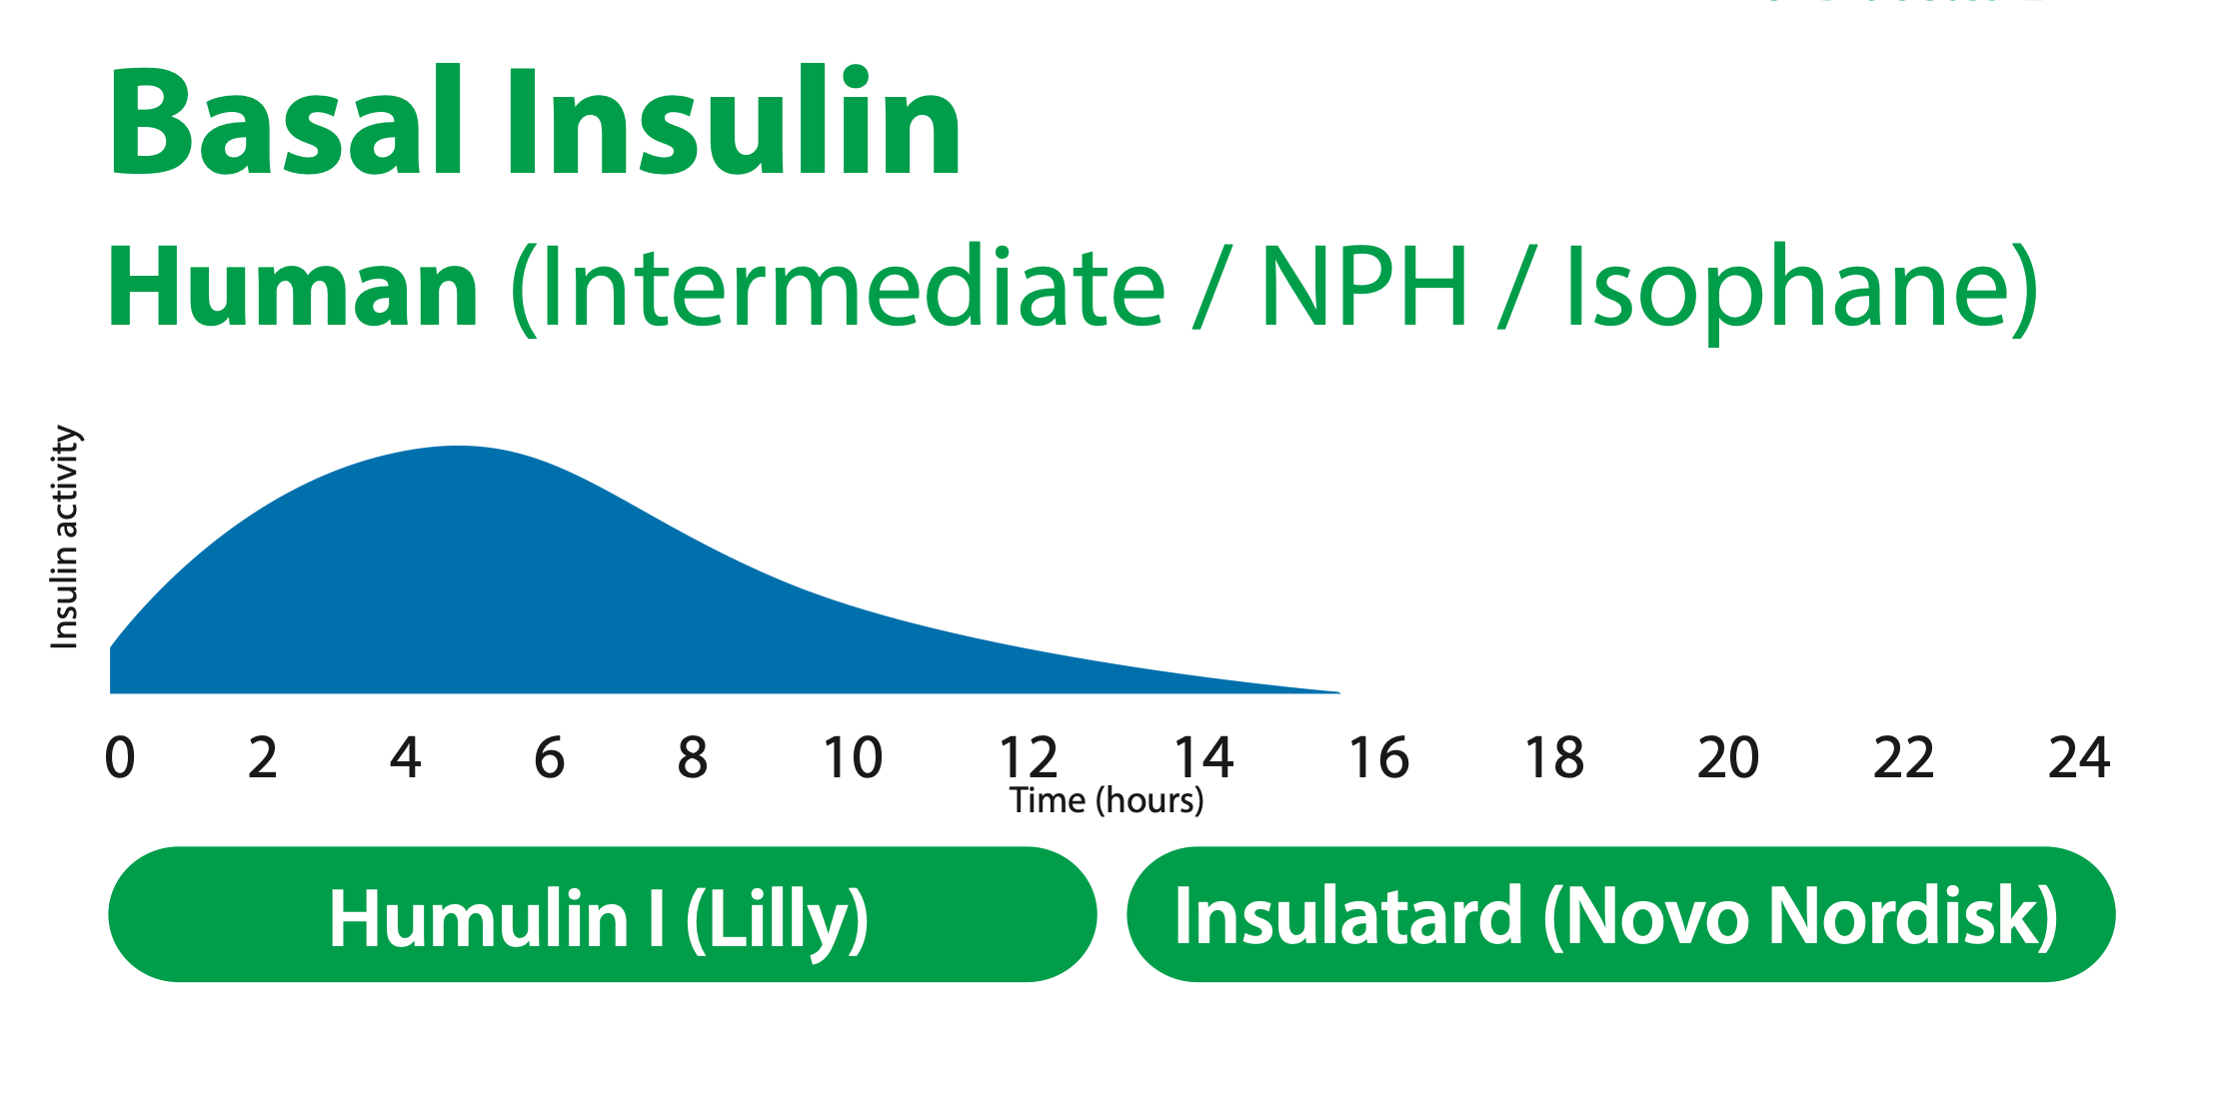
Names of insulin
Notes:
Taken From PITstop Course Resources (pitstopdiabetes.co.uk)

Slide 33
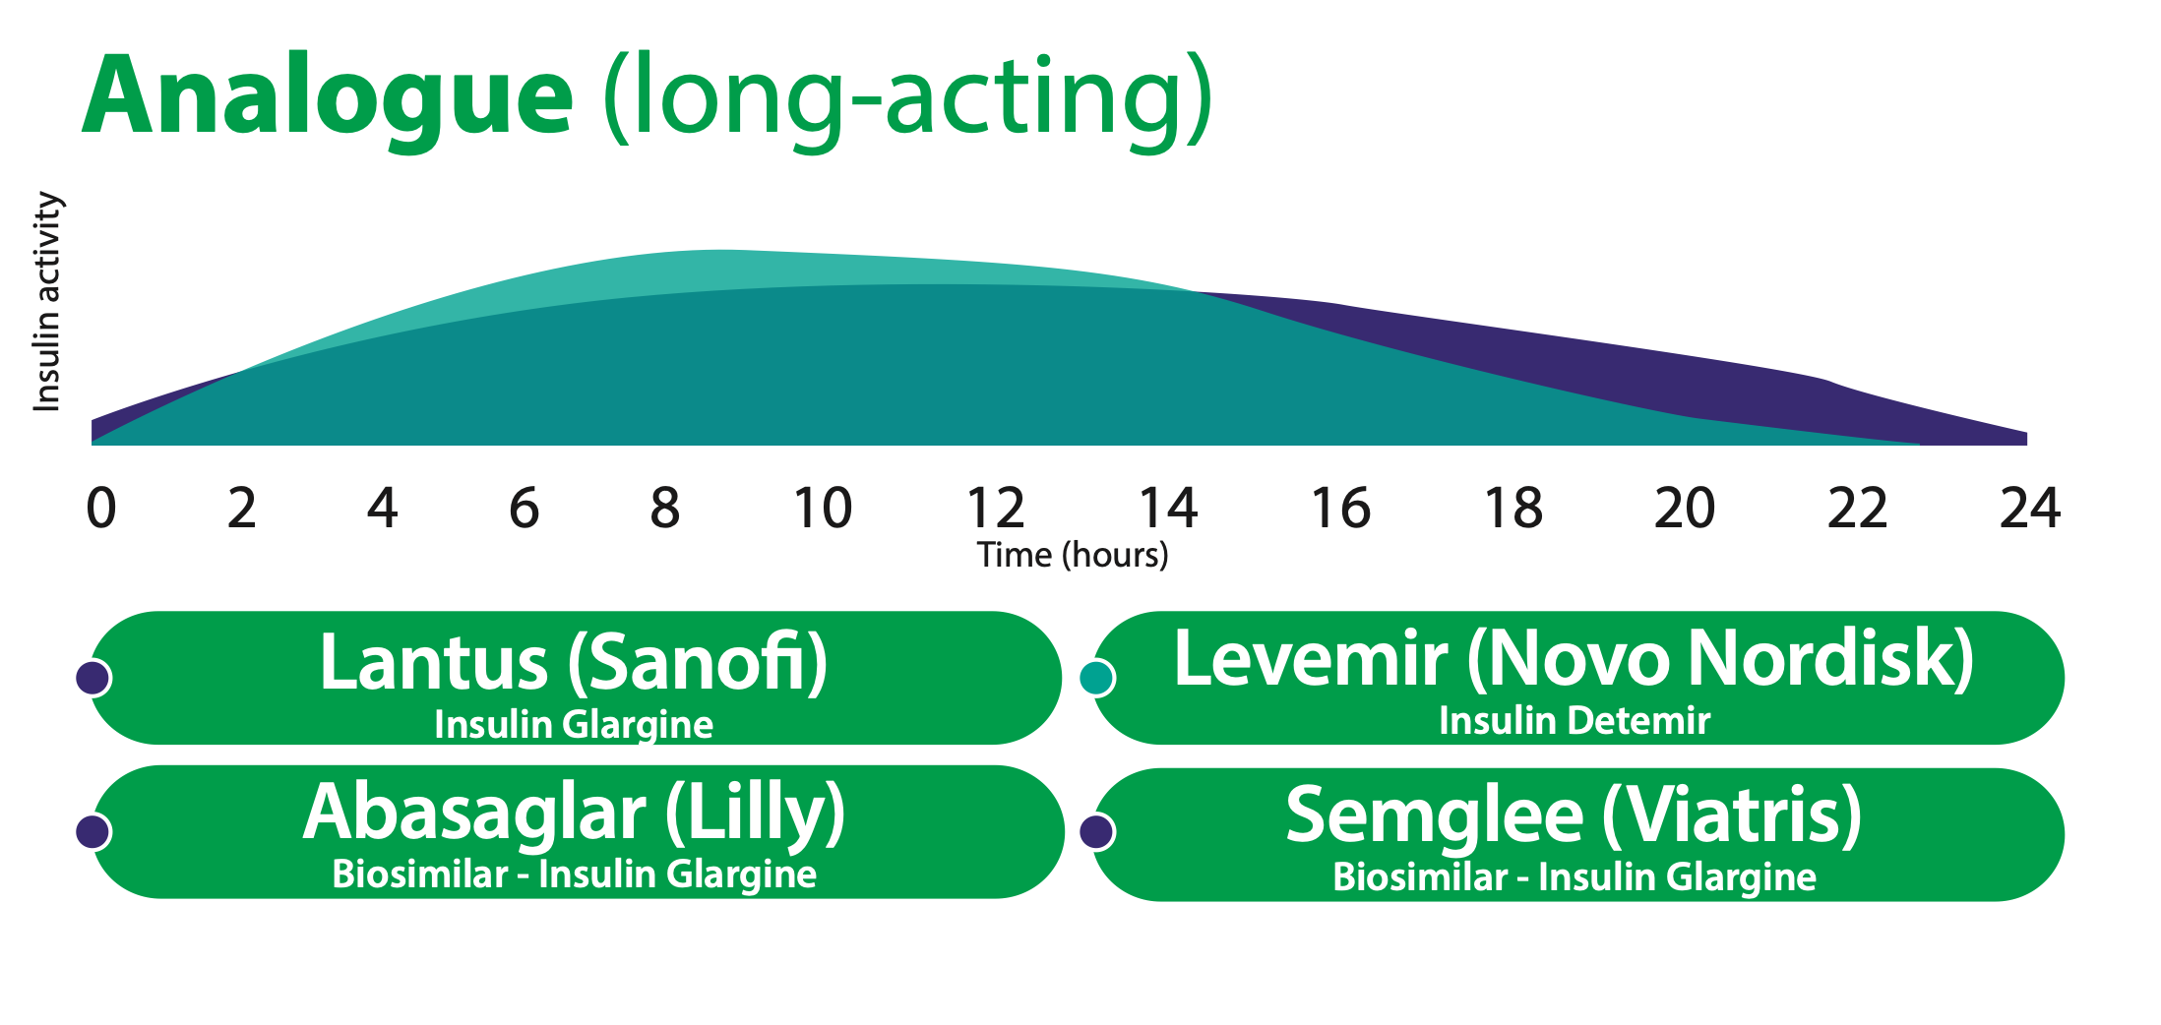
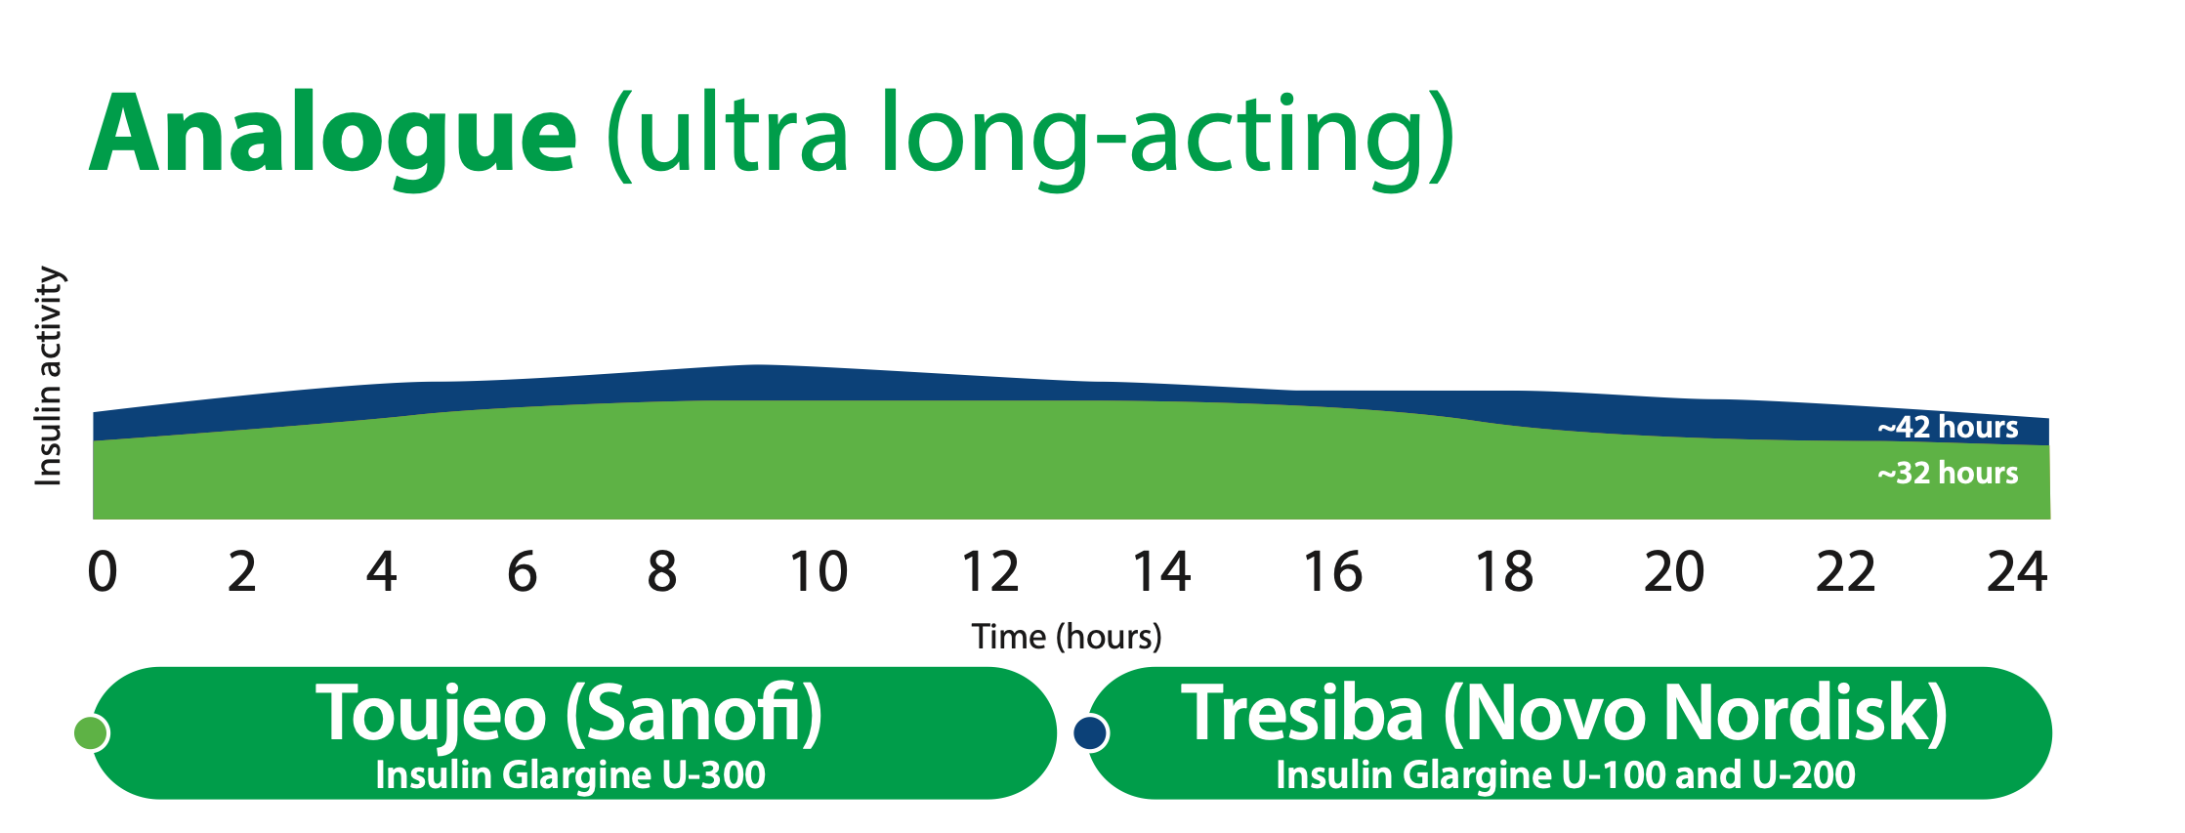
Notes:
Taken From PITstop Course Resources (pitstopdiabetes.co.uk)

Slide 34
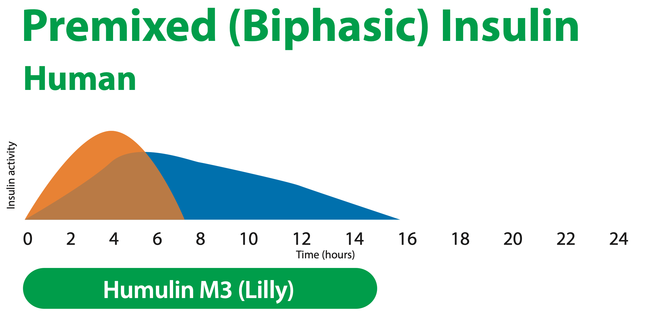
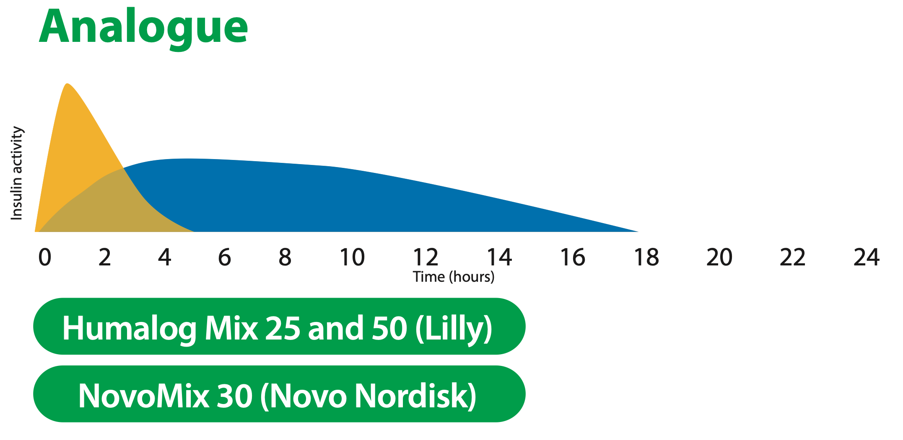
Notes:
Taken From PITstop Course Resources (pitstopdiabetes.co.uk)

Slide 35
Types of insulin regimes
Basal
Basal Bolus
Pre-mixed twice daily

Slide 36
NICE guidelines - Commencing Insulin
Offer neutral protamine Hagedorn (NPH) insulin injected once or twice daily according to need.
Consider, as an alternative to NPH insulin, using insulin detemir or insulin glargine if:
the person needs help from a carer or healthcare professional to inject insulin, and use of insulin detemir or insulin glargine would reduce the frequency of injections from twice to once daily or
the person's lifestyle is restricted by recurrent symptomatic hypoglycaemic episodes or
the person would otherwise need twice‑daily NPH insulin injections in combination with oral glucose‑lowering drugs.

Slide 37
If the HbA₁c remains suboptimal, especially if the HbA₁c is 75 mmol/mol (9.0%) or higher, you can consider escalation to NPH plus a short-acting insulin. These can be given separately or as a pre-mixed (biphasic) preparation

Slide 38
Terence
Terence was initiated on Humulin I 10 units by the intermediate diabetes team 6 months ago. He subsequently missed 2 appointments and was discharged by the team. He is not keen for a referral back.
He is also on metformin 1g BD and empagliflozin 25mg OD
He has come to see you as he is feeling increasingly thirsty.
He has been testing his fasting CBG which has been 16, 18, 17, 15
How would you manage him?
Notes:
Give him a target BM and ask to titrate the insulin by 2 units every 3 days.
Hypoglycaemia – reduce insulin 20%

Slide 39
Ethel
75 year old Ethel has had type 2 diabetes for 15 years. Her husband has noticed that she has episodes where she is slurring her speech. He usually gives her some chocolate and milk when these episodes occur.
On pre-mixed insulin 15units before breakfast and 20 units before dinner
BMs before breakfast 4.2, 3.1, 5.2, 14, 2.6
BMs before dinner 10.6, 14.7, 16.2, 13

Slide 40
Hypogylcaemia
Blood glucose below 4mmol/l
Shaking
Sweating
Headaches
Hunger
Tingling of the lips
Confusion
Unsteadiness
Palpitations
Irritability

Slide 41
Hypoglycaemia -
Missed or delayed meal
Eat less carbohydrate than expected
Unplanned exercise
Alcohol
Inject too much insulin by mistake
Dieting and losing weight but not adjusting insulin/ SU
Heat can cause insulin to be absorbed more quickly
Poor insulin injection technique
lipohypertrophy

Slide 42
Treating hypoglycaemia
Take 15-20g glucose
200ml of smooth orange juice
60mlglucojuice
5 glucotabs
6dextrosetablets
4 standard jelly babies
170-225ml Lucozade (2017)
Repeat treatment if blood glucose has not risen to 4 mmol/l after 15 minutes
A follow-up snack providing 15-20g of carbohydrate may be needed

Slide 43
Gary
Gary 52 yo taxi driver has come to see you as he has frequency of urine.
He has no other urinary symptoms.
T2DM
Background retinopathy – no DES in last 2 years
Hba1c 110
BMI 23 , GFR 80, ACR 5.7
Taking glimepiride, metformin, and sitagliptin
Notes:
Insulin requiring , apply group 2
How to persuade him – will not be able to drive if visual acuity problem ,
Whereas can drive with insulin , as long as no hypoglycaemia
Neuropathy – can he feel the pedal
SGLT2 not recommended as insulinopenic – normal body weight, low insulin reserve, high hba1c
Could try GLP1 , can be used BMI <35 if insulin would have significant occupational implications, sitagliptin would need to be discontinued
If he refuses insulin after being informed of the risks of long-term health problems ask him to sign a decleration

Slide 44
DVLA guidelines for patients on insulin
According to Diabetes UK 97% of non-commercial driving license renewals were successful in 2017
Must notify the DVLA
Have adequate awareness of hypoglycaemia
Report any episodes of severe hypoglycaemia to your diabetes team
Check blood glucose no more than 2 hours before the start of a journey and every 2 hours while driving.
Blood glucose must be above 5 mmol/l before driving
Attend regular diabetes reviews

Slide 45
Group 2 drivers
DVLA takes the following measures to ensure the requirements are met for licensing of insulin-treated Group 2 bus and lorry drivers:
applicants must stop driving Group 2 vehicles when they commence insulin until DVLA has made a licensing decision
the license application process cannot start until an applicant’s condition has been stable for at least 1 month, and they can provide 2 months of blood glucose readings taken whilst on insulin
arranges an examination to be undertaken every 12 months by an independent consultant specialist in diabetes
at the examination, the consultant will require sight of blood glucose self-monitoring records for the previous 6 weeks stored on the memory of a traditional blood glucose meter (not Continuous Glucose Monitoring System)
applicants will be asked to sign an undertaking to comply with the directions of the healthcare professionals treating their diabetes and to report any significant change in their condition to DVLA immediately
regular blood glucose testing – at least twice daily including on days when not driving

Slide 46
Diabetes and Illness
Sick Day Rules
Temporarily stop some drugs during acute illness
Metformin, SGLT2-I, Diuretics, ACEI, NSAIDs
Never stop taking insulin
Keep hydrated
Rest
Seek help if blood glucose continually high, vomiting and unable to keep water down

Slide 47
Jason
70 year old Jason Has Type 2 Diabetes. His diabetes is well controlled on metformin 1g BD and Dapagliflozin 10mg OD. You have diagnosed him with polymyalgia rheumatica and want to start him on oral prednisolone.
He tells you that the last time he was on prednisolone for an exacerbation of his COPD his CBG was very high.
What would you advise him?
Notes:
Agree blood testing with patient. Test before evening mealtime. If develops repeated high readings blood glucose >10mmol/l on >2 occasions - -add Gliclazide 40mgs with breakfast
Agree blood testing with patient.Test before evening mealtime. If develops repeated high readings blood glucose >10mmol/l on >2 occasions - -add Gliclazide 40mgs with breakfast
Assuming no hypoglycaemia symptoms:
Increase dose of Gliclazide in 40mg increments every 2-3 morning’s if needed, giving up to 240 mg in morning dose.(other SU – please ask for advice
Aim for blood glucose 7 mmol/l before evening meal when only on morning dose.

Slide 48
Hyperosmolar hyperglycaemic state
HHS occurs most commonly in older people with type 2 diabetes. Contributes to less than 1% of all diabetes-related admissions. However, mortality is high (5% to 15%).
Presents with polyuria, polydipsia, weakness, weight loss, tachycardia, dry mucous membranes, poor skin turgor, hypotension, and, in severe cases, shock.
Acute cognitive impairment (lethargy, disorientation, stupor) is common and correlates best with effective serum osmolality. Coma is rare and, if seen, is usually associated with a serum osmolality >340 mOsm/kg (>340 mmol/kg)
Treatment includes correction of fluid deficit and electrolyte abnormalities, and intravenous insulin.

Slide 49
Polly
Polly is a Type 1 diabetic who has booked an appointment with you due to 2 days of diarrhea and vomiting
Her diabetes is usually well controlled with her BMs usually in the range of 5-8.
She is on a basal bolus regime of insulin
She is checking her BMs twice a day
BM today has been 14 and 16
Notes:
Never stop insulin or reduce it, even if not eating
When patients who take insulin are unwell they need to be aware of the sick day rules. You should tell them to:
Never stop taking insulin or reduce it, even if not eating. There may be a need to increase the dose
Test blood glucose more often (at least every four hours, including during the night)
Drink lots of fluids to prevent dehydration
Replace normal meals with carbohydrate drinks if necessary
If your blood glucose level is 15 mmol/L or more (or 13 mmol/L if you use an insulin pump), test urine/blood for ketones
Seek medical advice if you develop vomiting or are unsure what to do.

Slide 52
TREND – managing insulin during illness
Notes:
If your blood glucose levels are dropping down to 4 mmol/L or less, reduce your insulin dose by 10%

Slide 53
Diabetic Ketoacidosis
Suspect DKA in a person with known diabetes or significant hyperglycaemia (finger-prick blood glucose level greater than 11 mmol/L) and the following clinical features:
Increased thirst and urinary frequency.
Weight loss.
Inability to tolerate fluids.
Persistent vomiting and/or diarrhoea.
Abdominal pain.
Visual disturbance.
Lethargy and/or confusion.
Fruity smell of acetone on the breath.
Acidotic breathing — deep sighing (Kussmaul) respiration.
Dehydration, which can be classified as:
Mild — only just clinically detectable.
Moderate — dry skin and mucus membranes, and reduced skin turgor.
Severe — sunken eyes and prolonged capillary refill time.
Shock (resulting from severe dehydration). The person is severely ill with:
Tachycardia, poor peripheral perfusion, and (as a late sign) hypotension (indicating decreased cardiac output).
Lethargy, drowsiness, or decreased level of consciousness (indicating decreased cerebral perfusion).
Reduced urine output (indicating decreased renal perfusion).

Slide 54
Conceiving
Needs to have good glycaemic control before trying for a baby; a target of HbA1_{c} less than 48 mmol/mol is recommended
Women with diabetes whose HbA_{1c} is above 86 mmol/mol (10%) should be strongly advised to avoid pregnancy. If it is safely achievable, women with diabetes who are planning to become pregnant should aim to maintain their HbA_{1c} below 48 mmol/mol (6.5%).
They should be reassured that any reduction in HbA_{1c} towards the target of 48 mmol/mol (6.5%) is likely to reduce the risk of congenital malformations. They should also be advised to take folic acid 5 mg per day until the 12th week of pregnancy to reduce the risk of neural tube defects

Slide 55
Keith
68 years old
Blood pressure 158/96
Hba1C 56
ACR 32 eGFR 52
Medication: Ramipril 10mg, Amlodipine 5mg, metformin 1g twice daily, gliclazide 40mg twice daily, sitagliptin 100mg once daily
How would you manage this patient?
Notes:
Add gliflozin, increase amlodipine 10mg, reduce/ stop gliclazide, add a statin 20mg

Slide 56
CVD and Blood pressure
Cardiovascular Disease biggest cause of death in diabetic patients
HTN major risk factor for CVD
Measure blood pressure at least annually in an adult with type 2 diabetes without previously diagnosed hypertension or renal disease
For adults with hypertension aged under 80, reduce clinic blood pressure to below 140/90 mmHg, 150/90 for those over 80
When using ABPM or HBPM to monitor the response to treatment in adults with hypertension
below 135/85 mmHg for adults aged under 80
below 145/85 mmHg for adults aged 80 and over.

Slide 57
Statin therapy
If an adult with type 2 diabetes does not have established cardiovascular disease (CVD), offer atorvastatin 20 mg once daily for primary prevention of CVD if:
The person is aged 84 years and younger, and their estimated 10-year risk of developing CVD is 10% or more.
The person is 85 years of age or older, taking into account the person's preferences, benefits and risks of treatment, and co-morbidities (including frailty and multimorbidity).
The person has a diagnosis of chronic kidney disease (CKD).
Established CVD should be on atorvastatin 80mg
Aim for a greater than 40% reduction in non-HDL cholesterol.Consider up-titration of the atorvastatin dose to achieve this target, if appropriate, depending on clinical judgement.

Slide 58
Chronic Kidney Disease with Albuminuria
ACEI to maximum tolerated dose
SGLT2-I
NiCE guidelines
For adults with type 2 diabetes and CKD who are taking an ARB or an ACE inhibitor (titrated to the highest licensed dose that they can tolerate), consider an SGLT2 inhibitor (in addition to the ARB or ACE inhibitor) if:
ACR is between 3 and 30 mg/mmol and
they meet the criteria in the marketing authorisation (including relevant eGFR thresholds).
Notes:
Offer SGLT2I if the ACR > 30

Slide 59
Peter
Hba1C 84
On metformin 2g MR, dapagliflozin 10mg, Humulin I 10 units twice a day, amitriptyline 20mg
Complaining of swollen right foot
Please perform a Diabetes foot Examination
What are your findings ?
What is the differential diagnosis?
How would you manage this?

Slide 60
Notes:
Charcot’s Joint (aka Charcot’s osteoarthropathy or Charcot’s neuroarthropathy) is most commonly seen as a complication of diabetes, but is also sometimes seen with syphilis. It is the result of peripheral neuropathy.
It results in swelling, redness and pain, typically the ankle, and sometimes involving other joints of the feet.
It can cause gross structural deformities, skin ulceration and may result in lower limb amputation. The onset of often insidious, and diagnosis frequently missed. It may be mistaken for cellulitis, gout or DVT or any other cause of lower limb pain, welling and redness.

Slide 61
Diabetes foot Assessment
When examining the feet of a person with diabetes, remove their shoes, socks, bandages and dressings, and examine both feet for evidence of the following risk factors:
Neuropathy (use a 10 g monofilament as part of a foot sensory examination).
Limb ischaemia
Ulceration.
Callus.
Infection and/or inflammation.
Deformity.
Gangrene.
Charcot arthropathy.
Notes:
The worry is that the ulcer becomes infected, and this may progress to osteomyelitis (bone infection) and sepsis that require amputation.
Foot ulceration is the most common complication of diabetes leading to hospital admission in the UK, accounting for around half of all foot amputations. There is a strong association between foot ulceration and mortality, with a 10% risk of death within one year of developing a foot ulcer. Following a major amputation, only around 50% will be alive after 2 years.²
Apart from the personal suffering, foot ulcers in individuals with diabetes and their complications are estimated to cost the NHS approximately £1bn per year – 0.8% of the total NHS budget

Slide 62
Assess current risk of developing a diabetic foot problem
Low risk: - no risk factors present except callus alone.
Moderate risk:
deformity or
neuropathy or
non-critical limb ischaemia.

Slide 63
High Risk
previous ulceration or
previous amputation or
on renal replacement therapy or
neuropathy and non-critical limb ischaemia together or
neuropathy in combination with callus and/or deformity or
non-critical limb ischaemia in combination with callus and/or deformity.
Active diabetic foot problem:
ulceration or
spreading infection or
critical limb ischaemia or
gangrene or
suspicion of an acute Charcot arthropathy, or an unexplained hot, red, swollen foot with or without pain

Slide 64
For people who are at low risk of developing a diabetic foot problem, continue to carry out annual foot assessments, emphasise the importance of foot care, and advise them that they could progress to moderate or high risk.
Refer people who are at moderate or high risk of developing a diabetic foot problem to the foot protection service.

Slide 65
Painful Diabetic Neuropathy
Offer a choice of amitriptyline, duloxetine, gabapentin or pregabalin as initial treatment for neuropathic pain
If the initial treatment is not effective or is not tolerated, offer one of the remaining 3 drugs, and consider switching again if the second and third drugs tried are also not effective or not tolerated.
Consider tramadol only if acute rescue therapy is needed
Consider capsaicin cream for people with localised neuropathic pain who wish to avoid, or who cannot tolerate, oral treatments.
Pain clinic

Slide 66
Neurological Complications
Diabetic peripheral neuropathy
Diabetic autonomic neuropathy
Cardiac autonomic neuropathy
Gastrointestinal autonomic neuropathy
Bladder dysfunction
Sudomotor dysfunction
Gustatory sweating
Diabetic amyotrophy (proximal motor neuropathy)
Notes:
Cardiac autonomic neuropathy – May have a silent MI, Decreased sweating, resting raised heart rate, Postural Hypotension, NICE advises standing BP to diagnose and monitor HTN
Bladder dysfunction – slow or incomplete bladder emtyping , UTIs, stress and urge incontinence
Sudomotor dysfunction – dryness of skin and feet
Gustatory sweating during or immediately after eating – patients may feel embarrassed
Diabetic amyotrophy iIt affects the thighs, hips, buttocks and legs, causing pain and muscle wasting. The condition tends to go on for several months but can last up to three years. By the end of this time it usually recovers, although not always completely. During its course it may be severe enough to necessitate wheelchair use.

Slide 67
Eye Disease
When adults are diagnosed with type 2 diabetes, refer them immediately to the local eye screening service.
Your results | Your next steps
No retinopathy (R0) | Continue your regular eye screening
Background changes (R1) | You may be asked to return sooner
Non-proliferative retinopathy (R2) | More regular eye screenings
Proliferative retinopathy (R3) | You will be seen by an eye specialist quickly and taken through your treatment options
Maculopathy

Slide 68
Arrange emergency review by an ophthalmologist for:
sudden loss of vision
rubeosis iridis
pre-retinal or vitreous haemorrhage
retinal detachment.
Refer to an ophthalmologist for any large sudden unexplained drop in visual acuity.

Slide 69
Periodontitis
A chronic inflammatory gum disease that destroys the supporting tissues of the teeth (the periodontium).
Gingivitis is a milder form of periodontal disease than periodontitis. However, gingivitis still causes inflammation in the gum, and if not treated it can lead to periodontitis.
they are at higher risk of periodontitis
if they get periodontitis, managing it can improve their blood glucose control and can reduce their risk of hyperglycaemia.
Advise adults with type 2 diabetes to have regular oral health reviews (their oral healthcare or dental team will tell them how often

Slide 70
Gastroparesis
Think in patients who have erratic blood glucose control or unexplained gastric bloating or vomiting, taking into account possible alternative diagnoses
To treat vomiting caused by gastroparesis in adults with type 2 diabetes:
consider alternating the use of erythromycin and metoclopramide
consider domperidone only in exceptional circumstances (if domperidone is the only effective treatment) and in accordance with MHRA guidance on domperidone. In December 2015, the use of erythromycin was off-label.
If gastroparesis is suspected, consider referring adults with type 2 diabetes to specialist services if:
the differential diagnosis is in doubt or
the person has persistent or severe vomiting.

Slide 71
Erectile Dysfunction
Offer men with type 2 diabetes the opportunity to discuss erectile dysfunction as part of their annual review.
Assess, educate and support men with type 2 diabetes who have problematic erectile dysfunction, addressing contributory factors such as cardiovascular disease as well as possible treatment options.
Consider a phosphodiesterase‑5 inhibitor to treat problematic erectile dysfunction in men with type 2 diabetes.
Refer men with type 2 diabetes to a service offering other medical, surgical or psychological management of erectile dysfunction if treatment (including a phosphodiesterase‑5 inhibitor, as appropriate) has been unsuccessful.

Slide 72
Questions

Slide 73
QUIZ
THE CODE IS 2066180 TO JOIN

